Slide 1
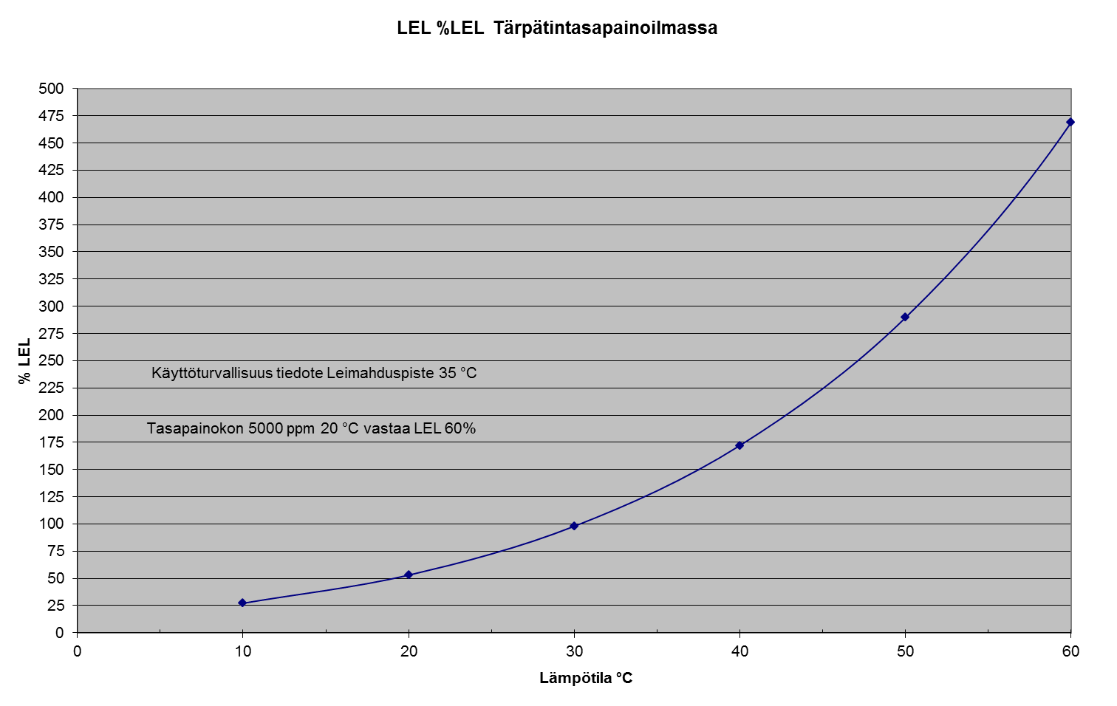
Huomioita:
Huomasin virheen kappaleessa 2.4.3 Rikkihappolaitos:
  rikkihappolauhduttimen jälkeen kaasuja ei johdeta laimeiden hajukaasujen järjestelmään, vaan piippuun. En tiedä miten meiltä oli lipsahtanut suomenkieliseen versioon tuollainen. Ehdotan, että korjataan asia käännökseen (kuten tein) ja suomenkieliseen versioon sitten seuraavassa revisiossa.
LEL %LEL, Turpentine in air (eq.)
% LEL
Flash point 35 °C (acc. to safety data sheet)
Eq. conc. 5000 ppm at 20 °C = LEL 60%
Temperature, °C

Slide 2
CNCG FROM COOKING
BYPASS (own stack within main stack)
EVAPORATION PLANT VACUUM SYSTEM
EVAP. FOUL CONDENSATE TANK
RB CNCG BURNER (secondary incineration place)
PRESSURIZED FIRING LIQUOR TANK
COOLING
VACUUM PUMP
H2SO4 PLANT & NaHSO3 PRODUCTION (primary incineration place)
EVAPORATORS
FOUL CONDENSATE STRIPPING
METHANOL LIQUEFACTION
STARTUP/SHUTDOWN
CNCG WATER SEAL TANK

Slide 3
CHIP BIN (live steam use)
CHIP BIN VENT HANDLING
BYPASS
(to main stack)
FIBERLINE DNCG
FIBERLINE DNCG
HANDLING
EVAPORATION DNCG
EVAPORATION
DNCG HANLDING
RB AREA
PRETREATMENT
RECOVERY BOILER
TALL OIL PLANT VENT
TALL OIL PLANT VENT HANDLING (H2S)
RECOVERY BOILER
Dissolving tank vent scrubber
RECOVERY BOILER
Mixing tank
RECOVERY BOILER
VENT HANDLING
DISSOLVING TANK VENT STACK
K/Cl REMOVAL PLANT
Mixing tank
RECAUSTICIZING
DNCG (hot sources)
RECAUSTICIZING
VENT HANDLING
LIME KILN
(recausticizing DNCG only)
STARTUP/SHUTDOWN
RECAUSTICIZING
Lime mud and dregs filters
BYPASS OUTSIDE
Notes:
Sivu 26

Slide 4
Alpha-pinene
Beta-pinene
Delta-3-carene
Partial pressure, bar
Temperature, °C

Slide 5
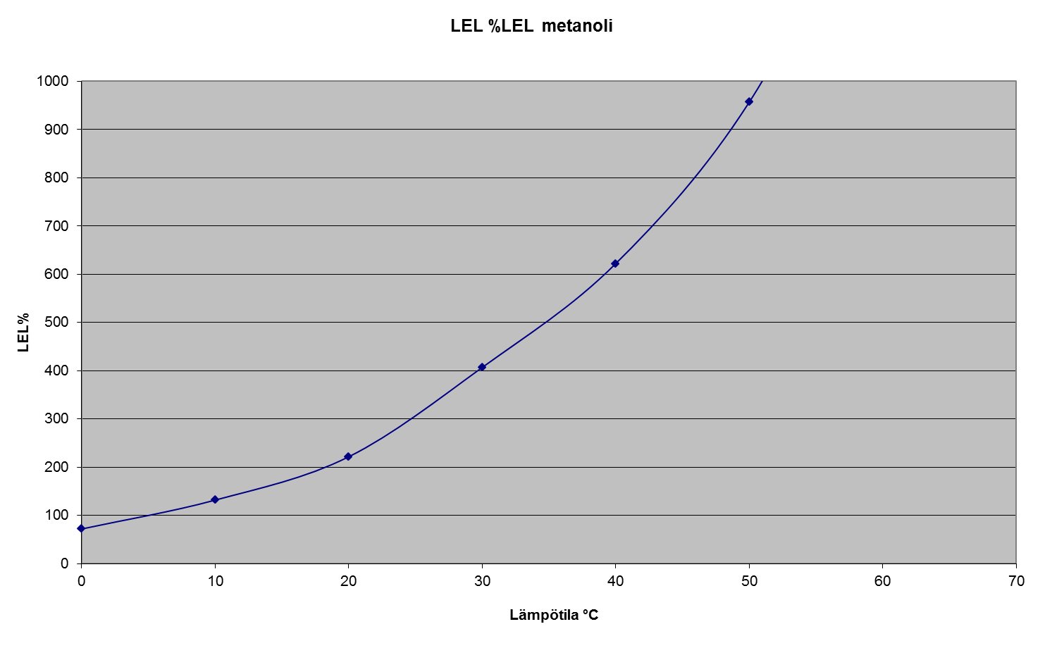
LEL %LEL methanol
Temperature, °C

Slide 6
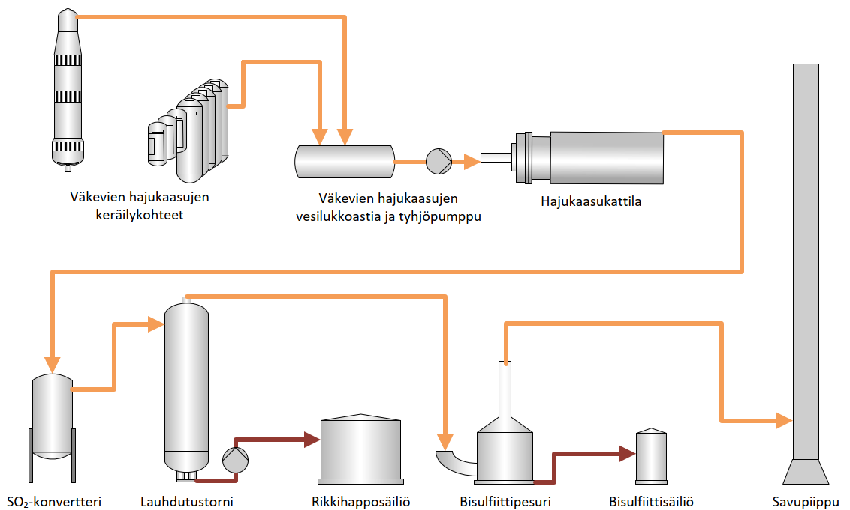
CNCG collection
CNCG water seal tank and vacuum pump
NCG boiler
SO2 converter
Cooling tower
H2SO2 tank
Bisulphite scrubber
Bisulphite tank
Stack

Slide 7
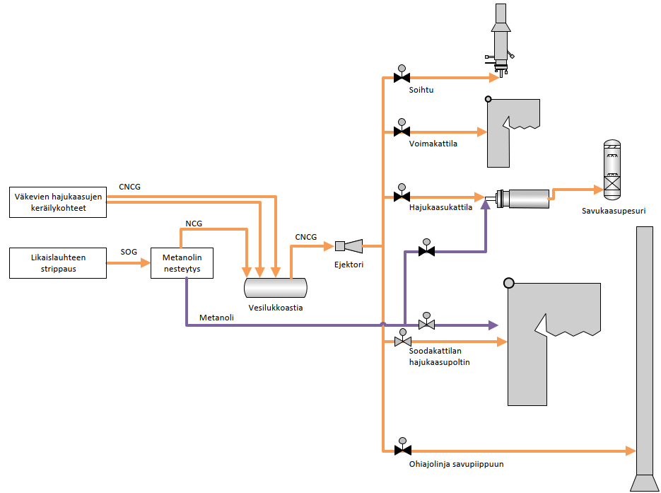
Flare
Power boiler
CNCG collection
NCG boiler
NCG scrubber
Foul condensate stripping
Methanol liquefaction
Ejector
Methanol
Water seal tank
RB CNCG burner
Bypass to stack

