Slide 1
CFD Modeling of Reduced Lignin Black Liquor Combustion Markus Engblom, Niko DeMartini, Åbo Akademi
Soodakattilapäivä 30.01.2014

Slide 2
Objective and CFD runs 1-3
CFD modeling for studying what operational changes may be needed when firing reduced lignin black liquor
CFD modeling of Wisaforest recovery boiler
Run 1: Base Case, 100% MCR, flue gas O₂ 3% (wet)
Runs 2 and 3: 10% and 20% lignin removed, total air adjusted for flue gas O₂ 3% (wet), other variables unchanged – presented here
Runs 4-7: 10% & 20% lignin removed, modifications to air distribution and liquor spraying – spray modifications presented here, air cases to be run this fall

Slide 3
Modeled Black Liquors (1/3)
 | Original Black Liquor (wt% d.s.) | Lignin [1] (wt% d.s.)
C | 32.2 | 64.5
H | 3.3 | 6
N | 0.09 | 0.1
Na | 21.4 | 0.3
K | 2.4 | 0.05
Cl | 0.3 | 0
Tot. S | 6.4 | 2.5
SO4 | 5.4 | 0
OH | 1.74 | 0
HHV (MJ/kg d.s.) | 13.2 | 26.5
Composition of reduced lignin BL
based:
Lignin content
of BL: 36 wt-%
175 kg H₂SO₄/ton
lignin precipitated [1]
1 Tomani, P. The lignoboost process. In Proceedings to The 2nd Nordic Wood Biorefinery Conf., 2-4 Sept. 2009,
Helsinki, Finland, pp. 181-188.

Slide 4
Modeled Black Liquors (2/3)
 | Original Black Liquor (wt% d.s.) | 10% lower lignin (wt% d.s.) | 20% lower ligning (wt% d.s.)
C | 32.2 | 30.9 | 28.9
H | 3.3 | 3.2 | 3.03
N | 0.09 | 0.09 | 0.09
Na | 21.4 | 22.8 | 23.9
K | 2.4 | 2.6 | 2.7
Cl | 0.3 | 0.32 | 0.34
Tot. S | 6.4 | 7.0 | 7.5
SO4 | 5.4 | 6.7 | 7.87
OH | 1.74 | 1.4 | 1.1
HHV (MJ/kg d.s.) | 13.2 | 12.4 | 11.6

Slide 5
Modeled Black Liquors (3/3)
 | Original Black Liquor | 10% lower lignin | 20% lower ligning
Liquor d.s. (wt-%) | 81.3 | 81.3 | 81.3
Volatiles (kg/kg d.s.) | 0.337 | 0.337 | 0.337
Char-C (kg/kg d.s.) | 0.143 | 0.103 | 0.074
Inorganics (kg/kg d.s.) | 0.516 | 0.555 | 0.585
Na₂S (kg/kg d.s.) | 0.115 | 0.120 | 0.121
Na₂SO₄ (kg/kg d.s.) | 0.080 | 0.101 | 0.118
Na₂CO₃ (kg/kg d.s.) | 0.320 | 0.335 | 0.345
HHV (MJ/kg d.s.) | 13.2 | 12.4 | 11.6

Slide 6
Liquor feed and combustion air
 | Original Black Liquor | 10% lower lignin | 20% lower ligning
Liquor feed (tds/d) | 5320 | 5160 | 5000
Of MCR (%) | 100 | 97 | 94
Air (kg/s) | 272 | 256 | 232
Air (Nm3/s) | 211 | 199 | 180
Primary | 23% | 23% | 23%
Secondary | 43% | 43% | 43%
Tertiary | 35% | 35% | 35%
Target flue gas O₂ (% wet) | 3.0 | 3.0 | 3.0

Slide 7
CFD calculation strategy
Set up Base Case
Liquor and air mass flows
Droplet size for C-balanced situation
Reduced ligning cases
Liquor to 10% or 20% reduced lignin
Total air for target 3% O₂ (wet flue gas)
Other variables remain the same

Slide 8
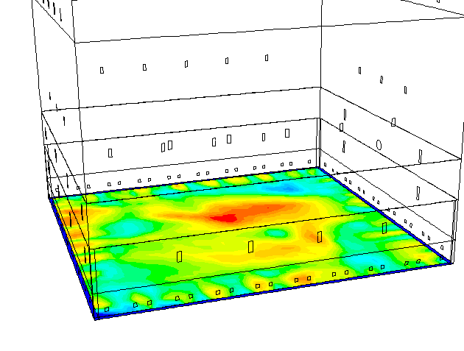
ÅA CFD Recovery Furnace Model
Fluent based
ÅA sub-models for droplets and char bed
Gas phase combustion
Droplet conversion
Char bed burning

Slide 9
Char bed burning model
Carbon input
by droplets
Char carbon
conversion
(g/s-m²)
Carbon accumulation

Slide 10
CFD results

Slide 11
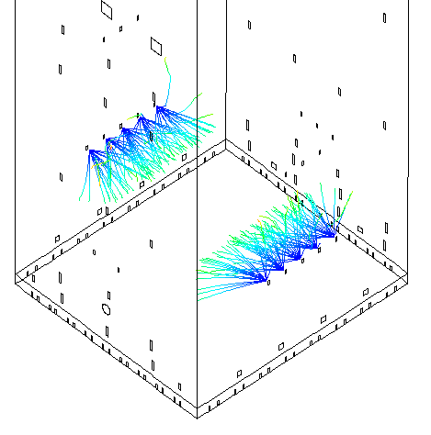
Wisa liquor gun locations
Guns on left and right wall; 5 guns/wall

Slide 12
Temperature
T (°C)
Original liquor
10% reduced lignin
20% reduced lignin
Side
view
Front
view

Slide 13
O₂ concentration
O₂
(mole fraction)
Original liquor
10% reduced lignin
20% reduced lignin
Side
view
Front
view

Slide 14
Carbon to walls/bed
Original liquor
10% reduced lignin
20% reduced lignin
(gC/s/m²)
≥
Left wall, back wall, and char bed

Slide 15
Carbon to walls/bed
Original liquor
10% reduced lignin
20% reduced lignin
(gC/s/m²)
≥
Right wall and front wall

Slide 16
Furnace char carbon loading
Bullnose
Tertair
Base Case
Tertair
-10% lignin
-20% lignin
Liquor
Sec air

Slide 17
Furnace carbon char conversion
Bullnose
Tertair
Base Case
Tertair
-10% lignin
-20% lignin
Liquor
Sec air

Slide 18
Fate of char carbon
(kg/s) | Base Case | 10% reduced lignin | 20% reduced lignin
In liquor feed | 8.81 | 6.19 | 4.30
in-flight conversion | 3.90 | 2.60 | 1.79
to bed/walls | 4.91 | 3.59 | 2.51
conversion on bed/walls | 4.70 | 4.37 | 4.10
carbon accumulation | 0.21 | -0.78 | -1.59

Slide 19
Fate of char carbon
(%) | Base Case | 10% reduced lignin | 20% reduced lignin
In liquor feed | 100.0 | 100.0 | 100.0
in-flight conversion | 44.3 | 42.0 | 41.6
to bed/walls | 55.7 | 58.0 | 58.4
conversion on bed/walls | 53.4 | 70.5 | 95.5
carbon accumulation | 2.3 | -12.5 | -37.1

Slide 20
Carbon accumulation and comb. air
 | Base Case | 10% reduced lignin | 20% reduced lignin
carbon accumulation (kg/s) | 0.21 | -0.78 | -1.59
Air to balance carbon (kg/s) | 2.4 | -8.9 | -18.2

Slide 21
Conclusions - Runs 1-3
Less char-C with lignin removal
Lower furnace less loaded with char-C
Dynamic situation of more carbon conversion than delivery
Operational changes
Reduce prim/sec air (runs 4 & 5) and/or
Change spraying – larger droplets (runs 6 & 7)

Slide 22
Runs 4 & 5 – Reduced air
Primary and secondary air need to be reduced to reflect the reduced char carbon load to the lower furnace
Not presented here - to be run this fall

Slide 23
Runs 6 & 7 – Larger Droplets
Larger droplets will result in more carbon reaching the lower furnace - to provide a carbon balance based on the original primary, secondary and tertiary air distribution
In practice this larger particle size distribution would be achieved by reducing the firing temperature or changing the spray angle or nozzle

Slide 24
CFD runs 6 and 7
Objective:
Increase char-carbon delivery to lower furnace until carbon accumulation ≈ 0
By increasing droplet size in liquor spray (lower liquor T)
Spray angle and nozzle unchanged
Run 6: 10% lignin removed
Run 7: 20% lignin removed

Slide 25
CFD runs 6 and 7
Note: Droplet size, liquor temperature, droplet velocity, etc – freely adjustable, independent parameters in CFD model
For Runs 6 and 7, droplet size, droplet velocity, and liquor temperature linked to each other in CFD model
How are droplet size and droplet velocity connected to liquor temperature?

Slide 26
Spray characterization (Miikkulainen et al.)
Nozzle A
Nozzle B
 | Nozzle A | Nozzle B
Nozzle pipe diameter | 27 mm | 28 mm
Splash plate angle | 23° | 36°
Nozzle exit area reduced by plate? | Partly reduced | Not reduced

Slide 27
Liquor T - droplet size – dependence
Nozzle A
Nozzle B

Slide 28
Liquor T - droplet size – dependence
Generic correlation for CFD
Dp(mm) = -1.46·T(°C)+32.5

Slide 29
Liquor T - droplet size – dependence
Nozzle A
Nozzle B
Correlation
Correlation

Slide 30
Liquor T - droplet velocity – dependence
Nozzle A
Dimensionless velocity, v(-)
Actual Liquor Velocity
v(-) =
Liquor Velocity assuming
no flashing

Slide 31
Liquor T - droplet velocity – dependence
Nozzle A
10% and 20% reduced lignin
Cases, liquor mass flow ~7 kg/s

Slide 32
Liquor T - droplet velocity – dependence
Nozzle A
Nozzle B
10% and 20% reduced ligning
Cases, liquor mass flow ~7 kg/s

Slide 33
Liquor T - droplet velocity – dependence
Generic correlation for CFD
v(-) = 0.057·T(°C)+0.668

Slide 34
Liquor T - droplet velocity – dependence
Nozzle A
Nozzle B
Correlation
Correlation
Exp
Exp

Slide 35
CFD runs 6 and 7 vs. Base Case
 | Base Case | 10% reduced lignin (Run 6) | 20% reduced lignin (Run 7)
Average droplet size | 5.7 mm | 12.5 mm | 23.0 mm
Initial droplet velocity | 15.0 m/s | 12.7 m/s | 9.2 m/s
Excess temperature | 18.4 °C | 13.7 °C | 6.5 °C
Liquor T changed from Base Case |  | -4.7 °C | -11.9 °C

Slide 36
Temperature (-10% lignin)
10% reduced lignin with dp 5.7 mm
10% reduced lignin with dp 12.5 mm
T (°C)
Side
view
Front
view

Slide 37
Temperature (-20% lignin)
20% reduced lignin with dp 5.7 mm
20% reduced lignin with dp 23.0 mm
T (°C)
Side
view
Front
view

Slide 38
Carbon to walls/bed (-10% lignin)
10% reduced lignin with dp 5.7 mm
10% reduced lignin with dp 12.5 mm
Original liquor
(gC/s/m²)
≥
Left wall, back wall, and char bed

Slide 39
Carbon to walls/bed (-10% lignin)
10% reduced lignin with dp 5.7 mm
10% reduced lignin with dp 12.5 mm
Original liquor
(gC/s/m²)
≥
Right wall and front wall

Slide 40
Carbon to walls/bed (-20% lignin)
20% reduced lignin with dp 5.7 mm
20% reduced lignin with dp 23.0 mm
Original liquor
(gC/s/m²)
≥
Left wall, back wall, and char bed

Slide 41
Carbon to walls/bed (-20% lignin)
20% reduced lignin with dp 5.7 mm
20% reduced lignin with dp 23.0 mm
Original liquor
(gC/s/m²)
≥
Right wall and front wall

Slide 42
Furnace carbon loading (-10%)
Bullnose
Tertair
Base Case
Tertair
-10% lignin
-10% lignin, dp 12.5 mm
Liquor
Sec air

Slide 43
Furnace carbon conversion (-10%)
Bullnose
Tertair
-10% lignin
Base Case
Tertair
-10% lignin, dp 12.5 mm
Liquor
Sec air

Slide 44
Furnace carbon loading (-20%)
Bullnose
Tertair
-20% lignin
Base Case
Tertair
Liquor
-20% lignin, dp 23.0 mm
Sec air

Slide 45
Furnace carbon conversion (-20%)
Bullnose
Tertair
-20% lignin
Base Case
Tertair
Liquor
-20% lignin, dp 23.0 mm
Sec air

Slide 46
Fate of char carbon (-10%)
(kg/s) | Base Case | 10% reduced lignin, dp 5.7 mm | 10% reduced lignin, dp 12.5 mm
In liquor feed | 8.81 | 6.19 | 6.19
in-flight conversion | 3.90 | 2.60 | 1.01
to bed/walls | 4.91 | 3.59 | 5.18
conversion on bed/walls | 4.70 | 4.37 | 5.16
carbon accumulation | 0.21 | -0.78 | 0.02

Slide 47
Fate of char carbon (-20%)
(kg/s) | Base Case | 20% reduced lignin, dp 5.7 mm | 20% reduced lignin, dp 23.0 mm
In liquor feed | 8.81 | 4.30 | 4.30
in-flight conversion | 3.90 | 1.79 | 0.24
to bed/walls | 4.91 | 2.51 | 4.05
conversion on bed/walls | 4.70 | 4.10 | 4.02
carbon accumulation | 0.21 | -1.59 | 0.03

Slide 48
Fate of char carbon (-10%)
(%) | Base Case | 10% reduced lignin, dp 5.7 mm | 10% reduced lignin, dp 12.5 mm
In liquor feed | 100.0 | 100.0 | 100.0
in-flight conversion | 44.3 | 42.0 | 16.3
to bed/walls | 55.7 | 58.0 | 83.7
conversion on bed/walls | 53.4 | 70.5 | 83.4
carbon accumulation | 2.3 | -12.5 | 0.3

Slide 49
Fate of char carbon (-20%)
(%) | Base Case | 20% reduced lignin, dp 5.7 mm | 20% reduced lignin, dp 23.0 mm
In liquor feed | 100.0 | 100.0 | 100.0
in-flight conversion | 44.3 | 41.6 | 5.7
to bed/walls | 55.7 | 58.4 | 94.3
conversion on bed/walls | 53.4 | 95.5 | 93.6
carbon accumulation | 2.3 | -37.1 | 0.7

Slide 50
Conclusions - Runs 6 and 7
With lignin removal and air split unchanged considerably larger droplets are needed to reach carbon balanced situation (=”steady operation”)
Estimated to correspond to a decrease in liquor temperature of 4.7 °C or 11.9 °C when 10% or 20% lignin removed respectively
Results suggest both liquor temperature and air distribution will need to be adjusted

Slide 51
Recommended Air Distribution – Runs 4 & 5
 | Run 4 | Run 5
Lignin Removed | 10% | 20%
Total Air (kg/s) | 256 | 232
Primary (kg/s) | 50 | 35
Secondary (kg/s) | 110 | 100
Tertiary (kg/s) | 96 | 97
Primary (%) | 20 | 15
Secondary (%) | 43 | 43
Tertiary (%) | 37 | 42

